Slide 1
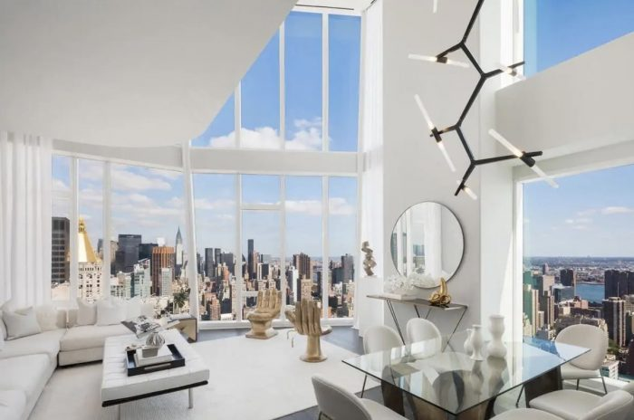
Airbnb Price Predictions – 03/25/21
Kapil Pundhir, Hillary Mandich, Cecilia Leung, Amaris Hassan, Caitlan Beachey

Slide 2

Airbnb Pricing Background
Notes:
This table shows you the coefficient of correlation (R2) & Mean Squared Error (MSE)
The r2 tells you how close the data fits to the regression line. MSE is the squared average difference between the actual & predicted values.
Based on the model, it tells us that the time trends have the strong impact on the price. The features have a moderate correlation to the price and the clustering have a fairly weak correlation

Slide 3
Exploratory Questions
Notes:
This table shows you the coefficient of correlation (R2) & Mean Squared Error (MSE)
The r2 tells you how close the data fits to the regression line. MSE is the squared average difference between the actual & predicted values.
Based on the model, it tells us that the time trends have the strong impact on the price. The features have a moderate correlation to the price and the clustering have a fairly weak correlation

Slide 4
Project process
Notes:
We have the following tables in our existing database. To strengthen our price model, we added 3 new tables to see how different factors like monthly, day of week & predicted prices can help hosts price their Airbnb units

Slide 5

Project Challenges
Consolidating new datasets to the existing database.
Large datasets slows down the process during the data transformation process.
Limited Connections to run the free version of the PostgreSQL.
Requires many trial runs to select the right features to find the best fit for the model.
Time Consuming to run the Hyperparameter Tuning for the test results as many combinations are tested to determine the overall test score.
Notes:
→ Rest of the team to add inputs

Slide 6
Database Change
EXISTING
NEW
Listings Masters
Borough ID
Neighbourhood ID
Room Type ID
Yearly Rates
Monthly Rates
Day of Week Rates
Predicted Rates
Notes:
We have the following tables in our existing database. To strengthen our price model, we added 3 new tables to see how different factors like monthly, day of week & predicted prices can help hosts price their Airbnb units

Slide 7
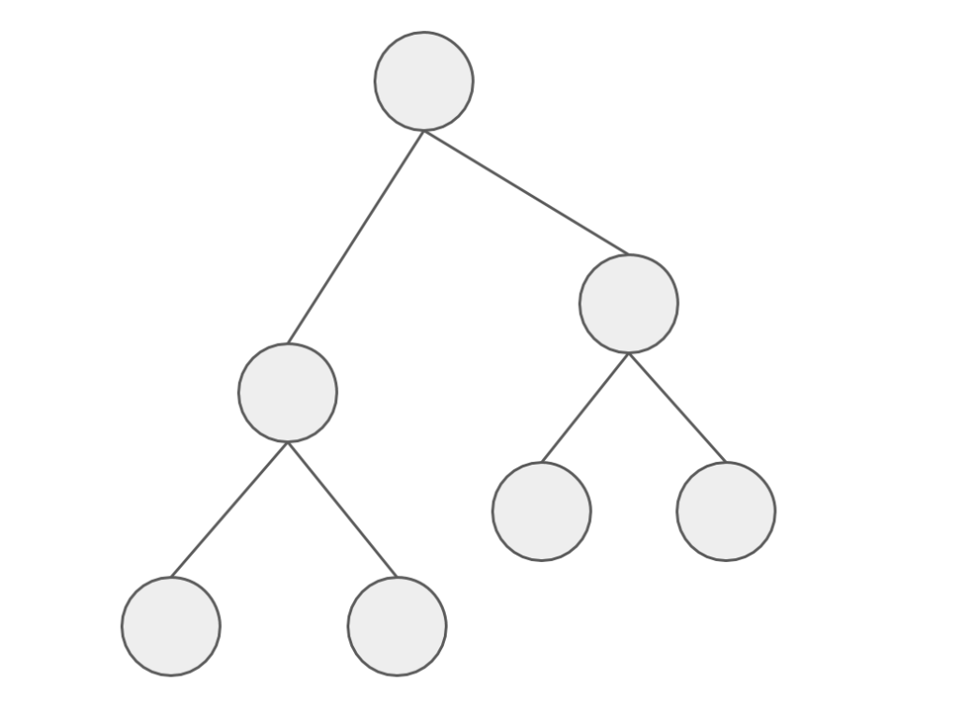
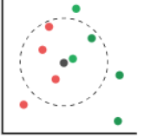
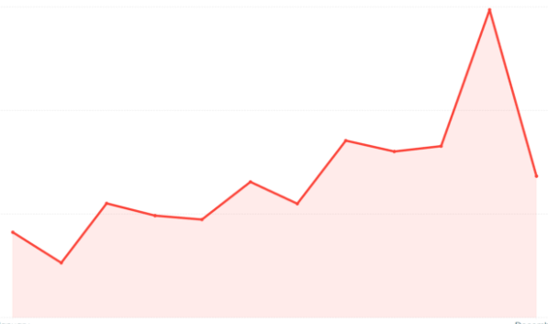
Model Analysis
Random Forest
LGBM
KNN
Facebook Prophet
Notes:
To cover majority of the factors in pricing a unit, we used the Random Forest & LGBM Regressor methods to determine which features are the most important to price an AirBNB.
We then use the KNN Regressor to see how the price is affected with having listings close to your area.
Finally, we used the Facebook Prophet to how prices are affected by time & seasonality to predict Airbnb future prices.

Slide 8

Model Findings
Location, room types, and number of bathrooms of a listing are important features to price a listing.
Moderate increase in price as the listing size increases.
Low-Moderate impact in predicting outcome based on local average of a specific area.
Prices fluctuate during different times of the year.
More uncertainty in the prices for the future.
Notes:
Before I go into explaining the modeling process, here are some of our key findings

Slide 9
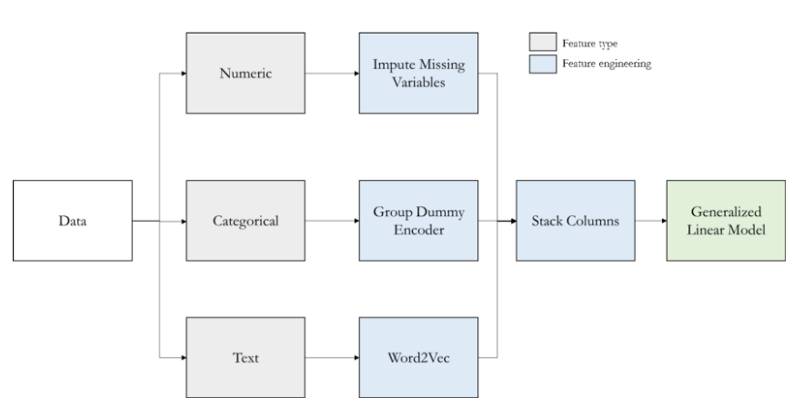
Model Data Transformation – RF, LGBM, KNN
Note: Used for Random Forest, LGBM and KNN Regressor Models only
Notes:
This table provides an overview of what we need to do to try to find the best fit for the model. The next few slides will provide a breakdown of what we did to transform the data.

Slide 10
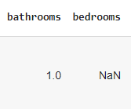


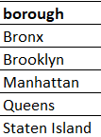
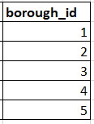

Model Data Transformation - RF, LGBM, KNN
1. Imputing Missing Numerical Data
2. Encoding Categorical Data
3. Vectorizing Text Data
Notes:
First, we needed to replace the blank fields with the averages for that specific column
Second, we need to put the data by categorize our data by numerical values which was done from our last project for boroughs, neighbourhoods & room type.
Then we also, vectorize the most important amenities to get a count for each listing.

Slide 11
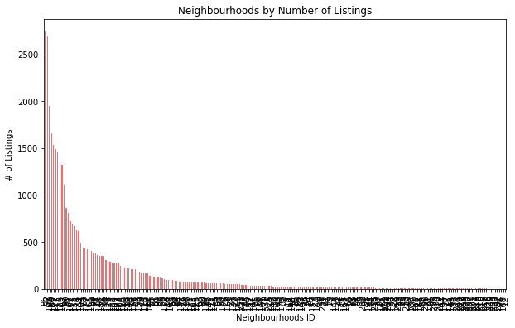
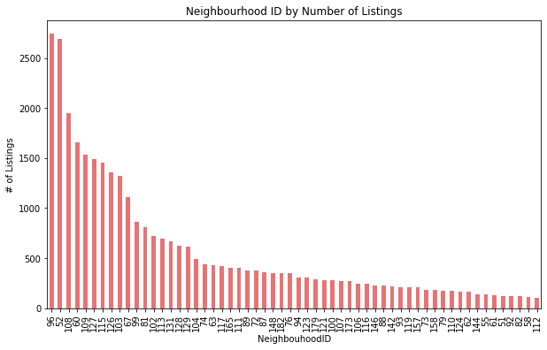
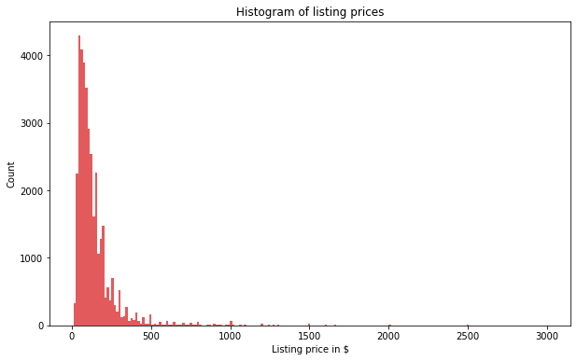
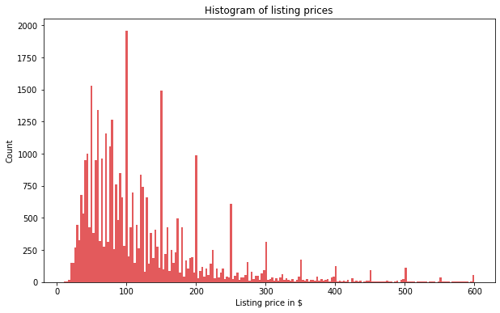
Model Data Transformation - RF, LGBM, KNN
4. Removing Outliers
Filter for:
1. ≥100 Listings
2. ≤ $600/night
Notes:
To get the best selection of listings that best represents NYC Airbnb market, 2e filtered out the outliers by only keeping the neighbourhoods that with over 100 listings & the listing prices under $600 so it is more normally distributed.

Slide 12
Model Data Transformation – FB Prophet
Listings Masters
Historical Rates
Holiday Dates
Existing
New
Prophet Model Datasets
Notes:
The facebook prophet runs differently than the other regressor model and another dataset needs to be created.
We used our existing data to find the listings masters data to get the borough and room type.
Then we need to created new datasets to find all the historial rates & holiday dates from 2017-2021. All this information is found on the inside Airbnb & us holiday calendar website.
Various methods like concatenation, filtering, merging, renaming columns and calculating the mean were used in Pandas to get our Final output
We believe that putting all of this together can help us accurately predict prices based on location, size, trends and seasonality.

Slide 13
Preprocessing Model Data
RF, LGBM, KNN Regressors
Define features (X-value) that have the most impact on the price (y-value)
Change test data size from 25% to 35% to provide more data to increase accuracy of the models.
Scale the X-values for normalizations to ensure all features are the same unit.
FB Prophet
Add the holiday features, borough and room type information to predict prices.
Notes:
The next step is that we need to select the right features that impact the price. We collectively agreed that features like location, the room type, # of bedrooms/bathrooms, amenities count review scores, # of reviews are some of the major driving force that impacts what the hosts charge for their Airbnb.
Then we increased the dataset size by 10% so that more listing simples can be tested to increase the accuracy of the test scores.
We must ensure that all x-values need to be scaled to the same unit so that it doesn’t give us the wrong scorres.
As for the prophet model, we added the holiday feature, borough and room type info form the original default code we have to
find the optimal train-test data split and to normalize the X-values so that they are in the same units for the model to produce to correct results.

Slide 14
Running the Preprocessing
Run the model by fitting the X and y data
Determine Coefficient correlation (r^2)
Determine Mean Squared Error (MSE)
Hyperparameter Tune the Model
Notes:
This table shows you the coefficient of correlation (R2) & Mean Squared Error (MSE)
The r2 tells you how close the data fits to the regression line. MSE is the squared average difference between the actual & predicted values.

Slide 15
Model Results
 | Random Forest (Features) | LGBM (Features) | KNN (Clustering) | FB Prophet (Seasonality Trends)
R² | 53% | 56% | 41% | 84%
MSE | 62.1 | 60.3 | 69.9 | 31.8
R2 = Coefficient of Correlation
MSE = Mean Squared Error
Notes:
This table displays the model r2 & mse scores. I have also listed the factors that the model takes in when predicting prices for the units.
Looking at the results, we cannot solely price your unit based on the average rates of the area as the KNN Regressor Model shows the lowest accuracy scores.
The hosts will need to look deeper into factors like room type, amenities, and other features to scale their rates accordingly.
Finally, the hosts maximize their revenue by looking at the traveling demands during different times of the year. For example, rates can be priced higher during the weekends, summer months, and on major holidays like Christmas.
The next slide will show the result breakdown of the Airbnb pricing model.

Slide 16
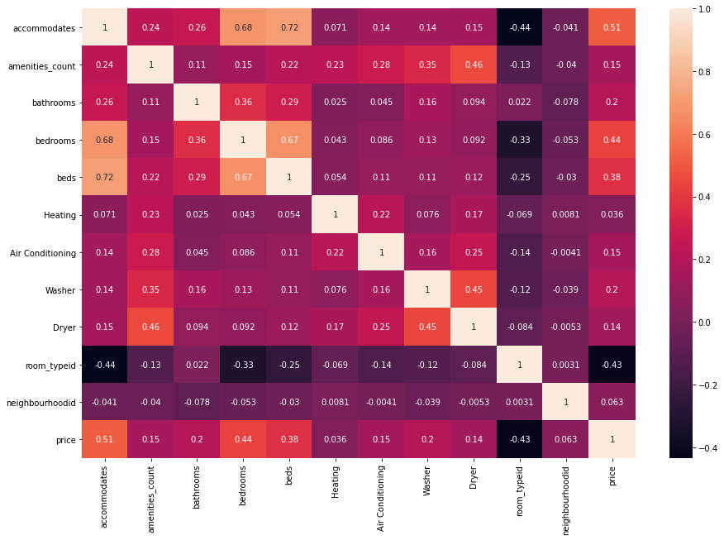
Model Results - Price Correlation
Accommodates
Bedrooms
Beds
Bathroom
Amenities Count
Notes:
In this slide we look at the price correlation versus the accommodations and amenities in the yellow box.
Just by looking at the correlation figures, the heatmap implies that size and basic accommodations have a moderate impact on the prices. Having more amenities like washer and air conditioning are nice to have features that can help increase the rates.

Slide 17
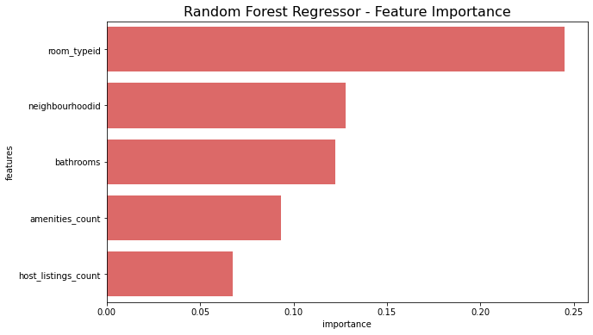
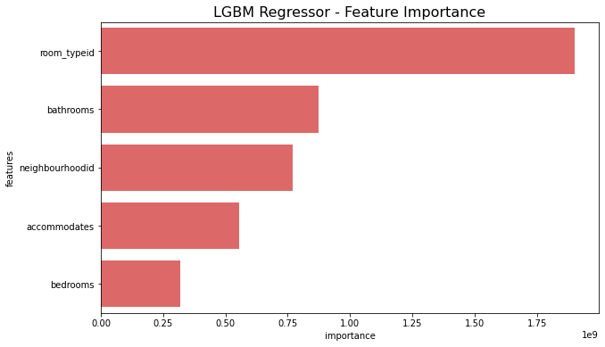
Model Results - Features

Slide 18
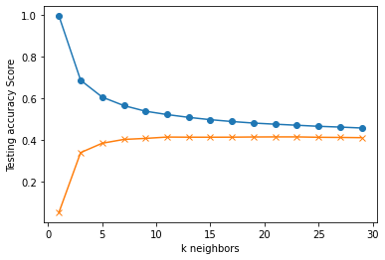
Model Results – Nearest Neighbours
Notes:
This table shows you the coefficient of correlation (R2) & Mean Squared Error (MSE)
The r2 tells you how close the data fits to the regression line. MSE is the squared average difference between the actual & predicted values.
Based on the model, it tells us that the time trends have the strong impact on the price. The features have a moderate correlation to the price and the clustering have a fairly weak correlation

Slide 19
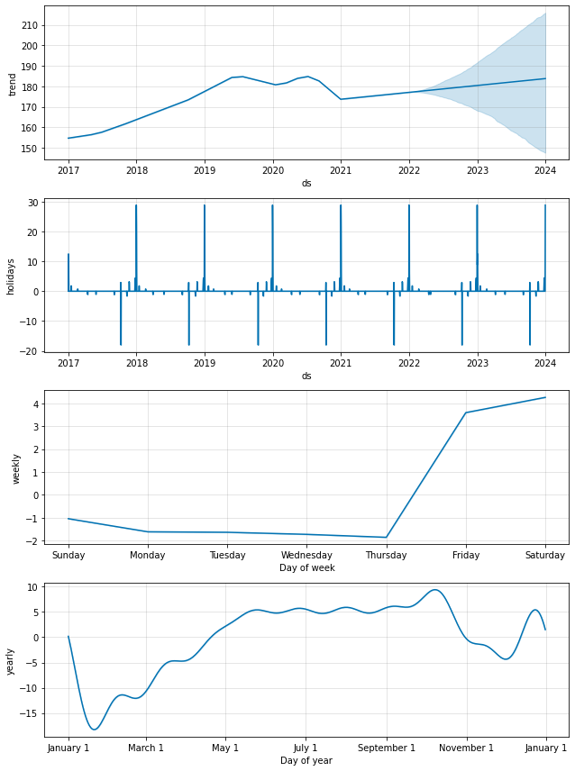
Model Results – Trends & Seasonality
Notes:
This table shows you the coefficient of correlation (R2) & Mean Squared Error (MSE)
The r2 tells you how close the data fits to the regression line. MSE is the squared average difference between the actual & predicted values.
Based on the model, it tells us that the time trends have the strong impact on the price. The features have a moderate correlation to the price and the clustering have a fairly weak correlation

Slide 20
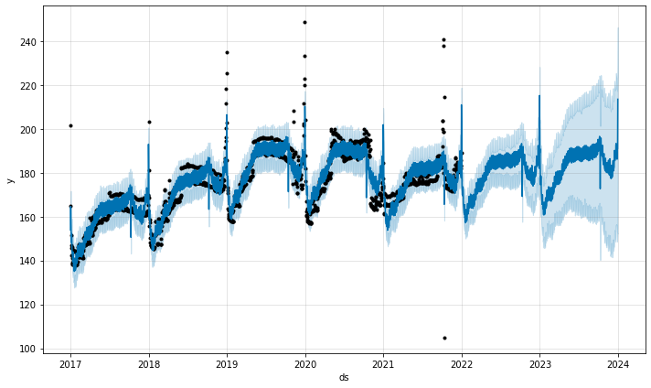
Model Results – Predict the Future
Notes:
This table shows you the coefficient of correlation (R2) & Mean Squared Error (MSE)
The r2 tells you how close the data fits to the regression line. MSE is the squared average difference between the actual & predicted values.
Based on the model, it tells us that the time trends have the strong impact on the price. The features have a moderate correlation to the price and the clustering have a fairly weak correlation

Slide 21
Pricing Considerations
In Order of Importance
Price the units at different rates during different times of the year.
Hosts can determine the pricing range based on the location and the size of their unit.
Prices can increase with more bedrooms & bathrooms.
Hosts can charge a bit more by providing more amenities.
Do extensive research on how neighbours price their units considering the room type they have.
Notes:
This table shows you the coefficient of correlation (R2) & Mean Squared Error (MSE)
The r2 tells you how close the data fits to the regression line. MSE is the squared average difference between the actual & predicted values.
Based on the model, it tells us that the time trends have the strong impact on the price. The features have a moderate correlation to the price and the clustering have a fairly weak correlation

Slide 22
Final Price Predictor Model
Modified Facebook Prophet Model that predict prices :
From 2017 - 2023
By Boroughs
By Room Type
Show Dashboard Image
Notes:
This table shows you the coefficient of correlation (R2) & Mean Squared Error (MSE)
The r2 tells you how close the data fits to the regression line. MSE is the squared average difference between the actual & predicted values.
Based on the model, it tells us that the time trends have the strong impact on the price. The features have a moderate correlation to the price and the clustering have a fairly weak correlation

Slide 23
Next Steps
Use AWS for the ETL to increase processing time
Add Neighbourhood Feature in the Prophet Model
Explore other Regressor Models
Webscrape New York City news info and include in Dashboard
[Gentrification] → Amaris to provide input
Notes:
This table shows you the coefficient of correlation (R2) & Mean Squared Error (MSE)
The r2 tells you how close the data fits to the regression line. MSE is the squared average difference between the actual & predicted values.
Based on the model, it tells us that the time trends have the strong impact on the price. The features have a moderate correlation to the price and the clustering have a fairly weak correlation

Slide 24
Dashboard Demo
Notes:
So & so we demo the dashboard

